Slide 1



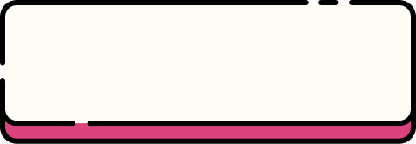


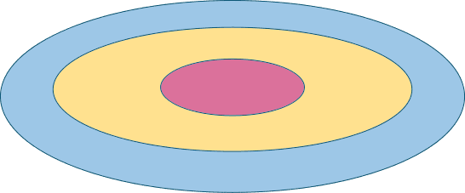

SYNOPSIS
Prepared By
Khushi, Aman, Mukul, Rohit
Under Supervision of
Monika Mam

Slide 2




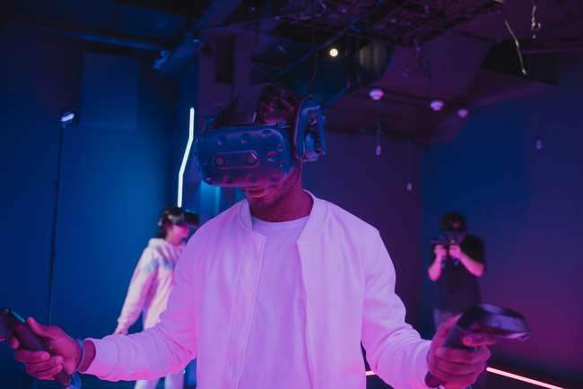

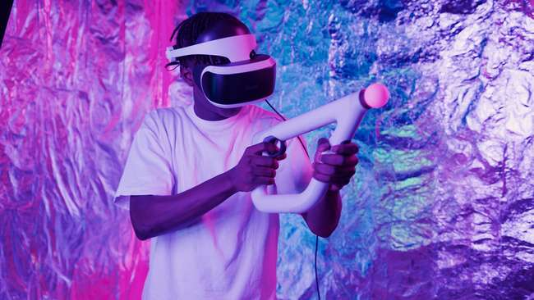
Team
Rohit Kumar
2401010255
Khushi Chauhan
2401010263
Mukul
2401010256
Aman
2401010261
Founder
Engineer
Integration Developer
Mobile Deployment Expert
The visionary behind the project. Leads the development process and ensures every component aligns with the goal of real-time sign language recognition.
Responsible for building and optimizing the machine learning models. Brings accuracy and intelligence to gesture recognition.
Handles the real-time video processing, user interface, and integration with hand tracking tools like MediaPipe.
Focuses on converting and deploying the model using TensorFlow Lite and integrating it into a mobile-friendly environment.

Slide 3













bridging the gap
Real Time Sign Language

Slide 4





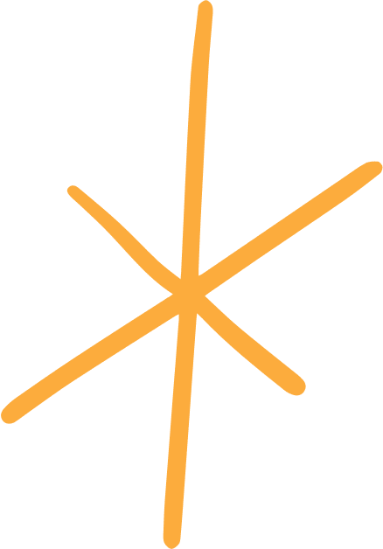

INTRODUCTION
Sign language is the primary mode of
communication for millions of people
with hearing or speech impairment.
This project aims to develop a real-time sign language translation application using machine learning enabling seamless communication by converting fine gestures into text or speech.
Reduces dependence on human interpreters,
making communication more Independent
and efficient.

Slide 5






objectives:
User-Friendly Interface
Real-Time Gesture
Recogination
Accessibility & Inclusivity
High Accuracy & Efficiency

Slide 6




problem statemets:
Communication barriers between sign language users and a non-sign language users create significant challenges in everyday interactions.
The project aims to develop a real-time sign language translation application using machine learning to bridge this gap.
By leveraging AI-driven gesture recognition, the application will convert sign language into text or speech instantly.

Slide 7
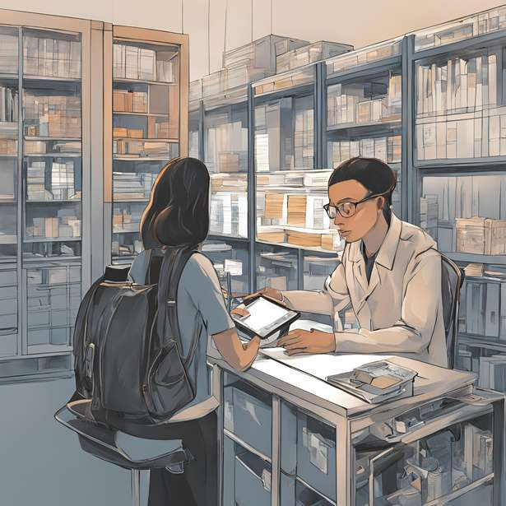






METHODOLOGY
Data
collection
gesture recognition
model development
display output
user
interface
deployment

Slide 8
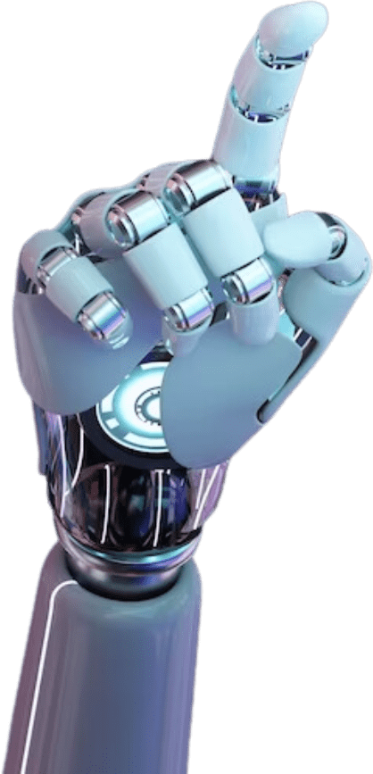
SOFTWARE USED
Python: Programming Language
Mediapipe: Hand tracking
OpenCV: Video processing
TenserFlow / Keras : Model training
Numpy/ Pandas: Data handling
Matplotlib: Visualization
TensorFlow Lite: Mobile deployment
Jupyter Notebook: Development network

Slide 9


01
Accurate Sign Language Recognition
02
Seamless Text & Speech Recognition
03
User-Friendly Interface
04
Multi-Language Support
05
Robust Machine Learning Model
06
Real Time Processing
Expected outcomes:
07
Hardware Compatibility
08
Scalability & Future Enhacements

Slide 10


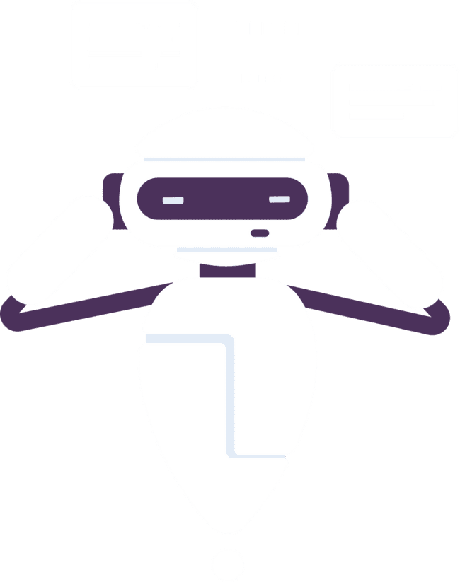

Healthcare:
Education:
Applications
Enables doctor and nurses to understand patient using sign language Where interpreters are unavailable in emergency.
Helps students with hearing impairments communicate with teachers and peers.
Workplace &Employment:
Customer Service & Business:
Encourages inclusivity by allowing Employees with hearing impairments to communicate with colleagues.
Enhances interactions in banks, retail stores and government offices.
Emergency Situation:
Helps first responders and law enforcement communicate quickly with individuals using sign language.

Slide 11

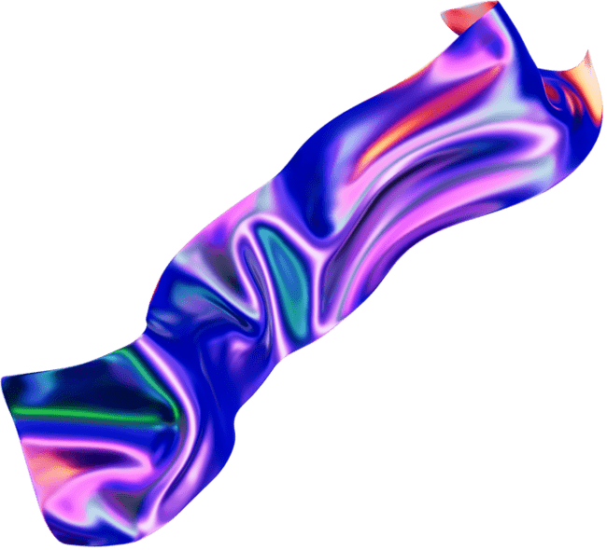



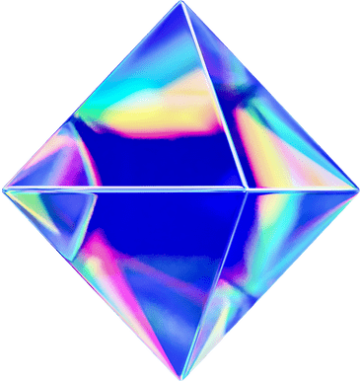
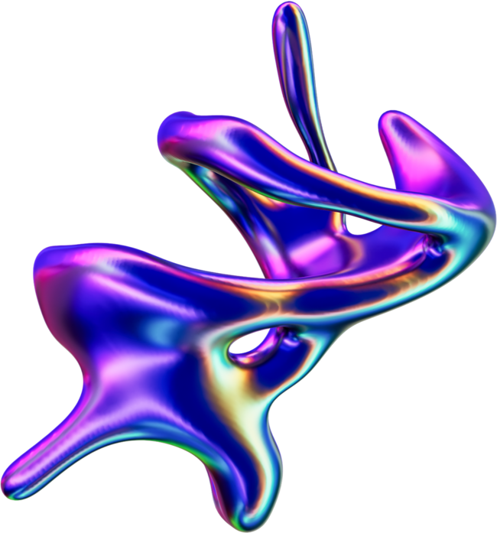

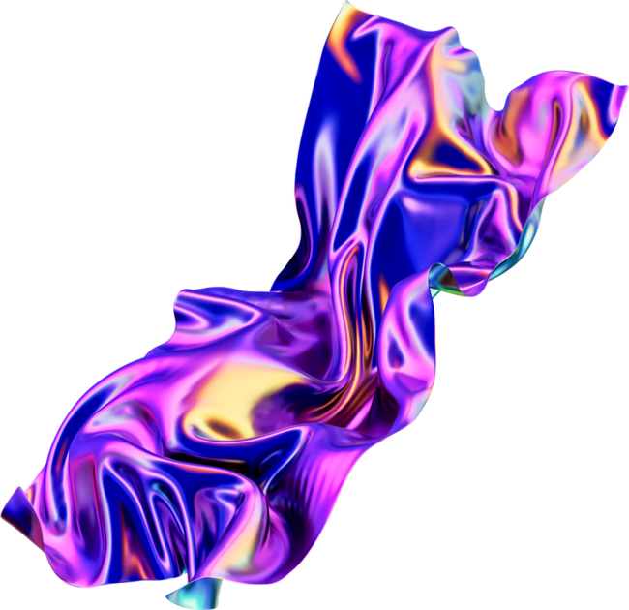
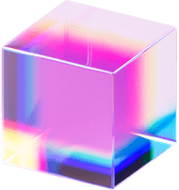

CONCLUSION
The development of a real-time sign language translation application using machine learning represents a significant step towards bridging the communication gap between the Deaf and the hearing communities.
By Leveraging advanced Technologies such as computer vision, deep learning and natural language processing these application can accurately recognise and translate sign language into spoken or written text in real time.
Despite the promising advancements, challenges such as data set limitation, variations in sign language across region and real time processing constraints remain areas force further research.
Overall, real time sign language translation powered by machine learning has the potential to create a more inclusive and accessible society, fastering better communication and social integration for individuals with hearing in impairments.

Slide 12




